Slide 1
BYU-SCUT EXCHANGING PROGRAME
Presented by: (in alphabet order)
Ada
Lucifer
Luke
Michelle
Ronnie*

Slide 2
Contents
Introduction
Exchange Programs SCUT provides
School of Architecture exchanging program
School of Materials exchanging program
SCUT environment
Exchange Program SCUT suggests
School of Management exchanging program
Conclusion

Slide 3
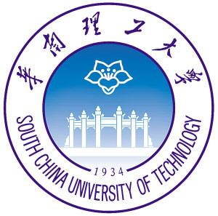
Introduction
25,000 undergraduates and 18,000 postgraduates
Dedicated to educating engineers for 60 years
Ranked 138 worldwide by Leiden in 2013
China’s first-level university
Industry technology, Architecture, Materials Science…

Slide 4

Introduction
One of the largest private universities in U.S.
28,000 undergraduates and 2,000 full-time postgraduates
Ranked 62nd in the U.S. by U.S.News in 2013
Marriott School of Management received a No.5 ranking by Business Week in 2009
MBA program ranked 92nd among business schools worldwide.

Slide 5
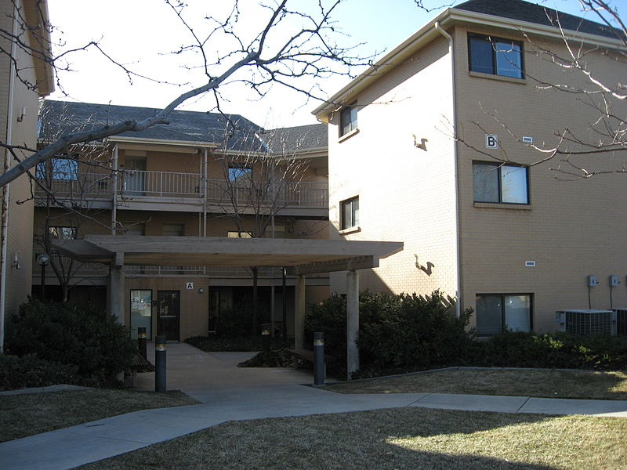
FOUNDATION OF COOPERATION?
Both are worldwide famous universities
For the BYU:
Strong engineering background in SCUT
A longer exchanging program in China
For the SCUT:
A multi-language environment
China needs more specialists
International Students Dormitory

Slide 6
COLLEGE OF MATERIALS SCIENCE AND ENGINEERING
Historical college
Abundant funding
Two majors for exchange project
Materials science
Material processing project

Slide 7
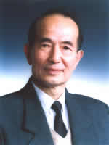
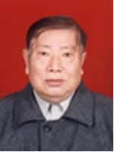
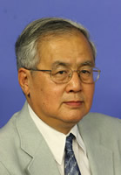
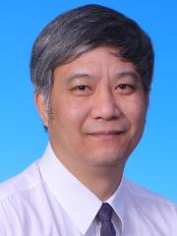
WE HAVE THE FIRST-CLASS FACULTY
High level teachers
270 people in-service
71 doctoral supervisors
151 master supervisors
9 academicians of CAS

Slide 8
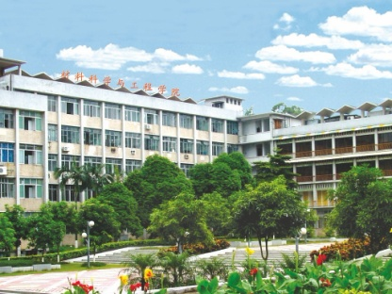
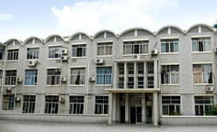
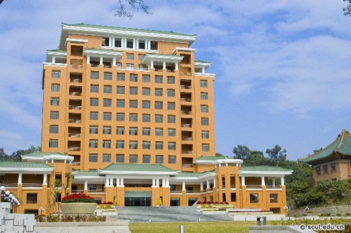
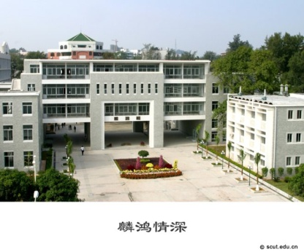
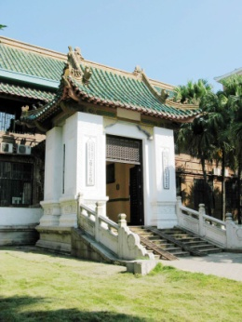
MODERN TEACHING FACILITIES
College of materials now consists of 5 faculties, 6 Research Institute, 1 national key laboratory, 1 national engineering research centers and 5 provincial and ministerial key laboratories, 4 provincial engineering research centers, and one State-level experimental teaching demonstration Center.

